Slide 1
BOOLEAN ALGEBRA
CHAPTER -13

Slide 2
Boolean Algebra
Boolean algebra is a mathematical system for the manipulation of variables that can have one of two values.
  In formal logic, these values are “true” and “false.”
  In digital systems, these values are “on” and “off,” 1 and 0, or “high” and “low.”
Boolean expressions are created by performing operations on Boolean variables.
  Common Boolean operators include AND, OR, and NOT.

Slide 3
BINARY VALUED QUANTITIES
DEFINITION :
  THE DECISION which results into either YES /TRUE OR NO/FALSE
TAUTOLOGY :
  If the result of any logical statement or expression is always TRUE or 1
FALLACY :
  If the result is always FALSE or 0

Slide 4
LOGICAL OPERATORS
TRUTH TABLE
  Table which represents all the possible values of logical variables / statements along with all the possible results of the given combinations of values
Operators
  NOT
  OR
  AND

Slide 5
LOGICAL OPERATIONS
A logical statement “A” is either TRUE or FALSE.
Logic operations
  NOT (Complement) changes TRUE to FALSE, and v.v. (A’, /A, )
  AND — “A AND B” is true if A and B are individually true (A•B, AB, A&B, A.B)
  OR — “A OR B” is true if either A or B is true (both may be true) (A+B,A|B, A.B).

Slide 6
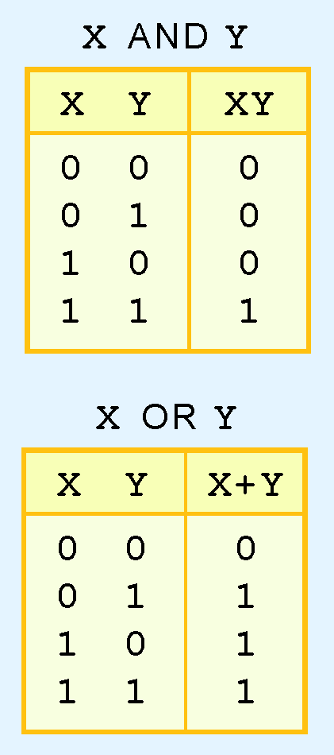
Boolean Algebra
A Boolean operator can be completely described using a truth table.
  The AND operator is also known as a Boolean product.
  The OR operator is the Boolean sum.

Slide 7
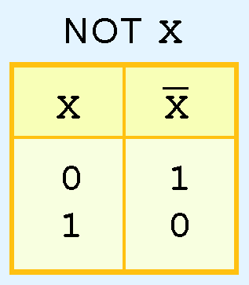
Boolean Algebra
  The NOT operation is most often designated by an overbar. It is sometimes indicated by a prime mark ( ‘ ) or an “elbow” (¬).

Slide 8
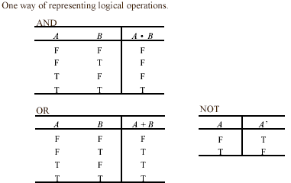
TRUTH TABLES
Represents all the possible values of logical variables / statements along with all the possible results of the given combination of values.

Slide 9
SOME EXAMPLES OF TRUTH TABLES FOR EXPRESSIONS

Slide 10
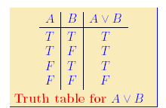
A + C

Slide 11
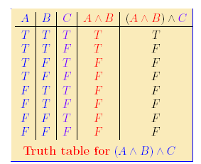
A . B . C

Slide 12
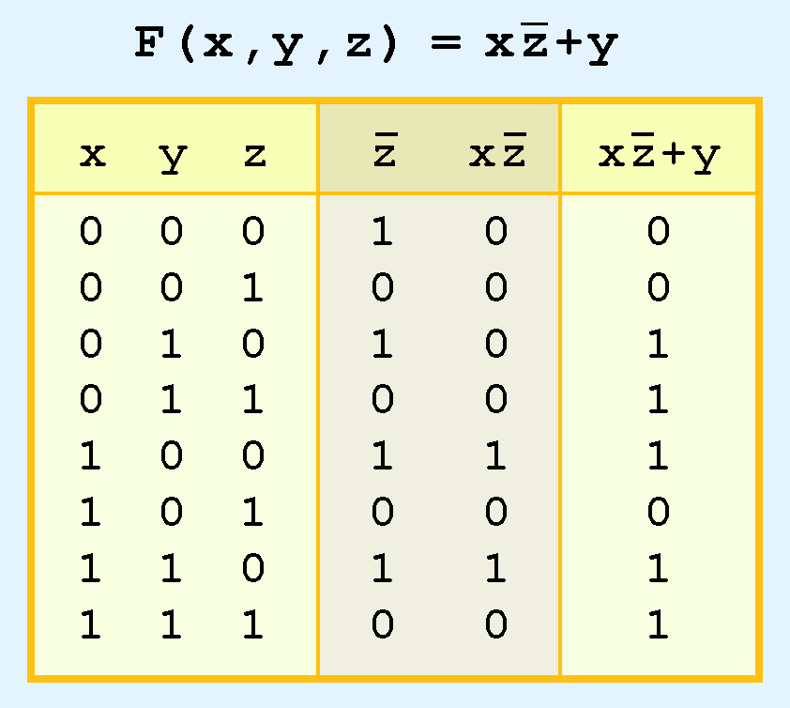
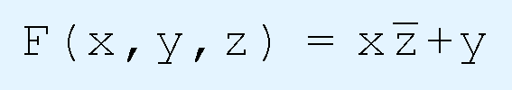
Boolean Algebra
The truth table for the Boolean function:
is shown at the right.
To make evaluation of the Boolean function easier, the truth table contains extra (shaded) columns to hold evaluations of subparts of the function.

Slide 13
EXERCISES
WRITE DOWN TRUTH TABLE FOR
  (A.B).C
  (A+B)+C
  A.BC
  (A+B).C

Slide 14
LOGIC GATES

Slide 15
Definintion
  An electronic circuit which operates on one or more signals to produce an output signal

Slide 16
AND GATE:
  Can have 2 or more than 2 input signals and produce 1 output signal. When all the inputs are 1 i.e. High then the output is 1 otherwise output is 0 only.
OR GATE
  Has 2 or more than 2 input signals and produce 1 output signal. If any of the inputs is 1 i.e. High the output is 1 or high.
NOT GATE (INVERTER)
  With only one input signal and one output signal . the output state is always the opposite of the input state.

Slide 17
The three simplest gates are the AND, OR, and NOT gates.
They correspond directly to their respective Boolean operations, as you can see by their truth tables.

Slide 18
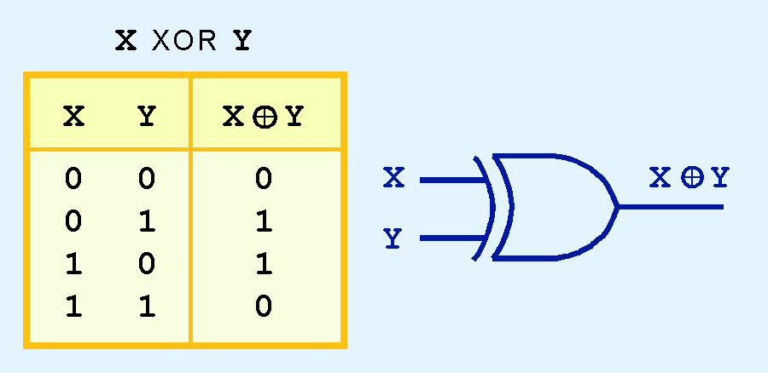
Another very useful gate is the exclusive OR (XOR) gate.
The output of the XOR operation is true only when the values of the inputs differ.
Note the special symbol ⊕ for the XOR operation.

Slide 19
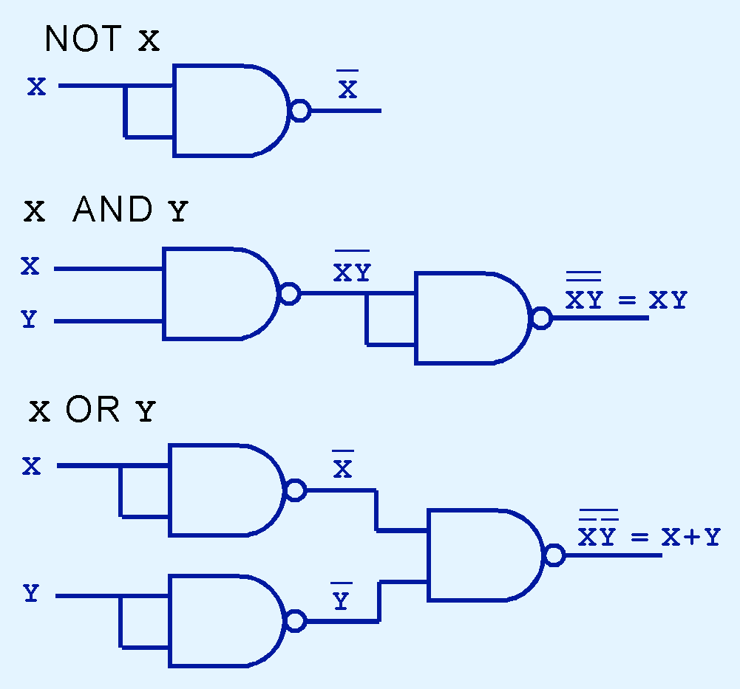
Logic Gates
NAND and NOR are known as universal gates because they are inexpensive to manufacture and any Boolean function can be constructed using only NAND or only NOR gates.

Slide 20
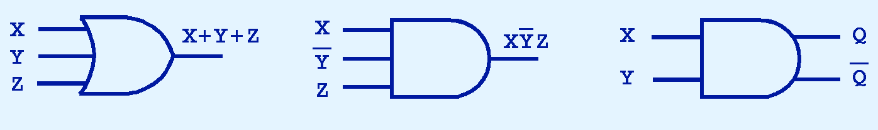
Logic Gates
Gates can have multiple inputs and more than one output.
  A second output can be provided for the complement of the operation.

Slide 21
The principle of Duality
Starting with a Boolean relation , another Boolean relation can be derived by
  Changing each OR sign (+) to an AND sign(.)
  Changing each an AND sign(.) to OR sign (+) .
  Replacing each 0 by 1 and each 1 by 0.
The derived relation using duality principle is called DUAL OF ORIGINAL EXPRESSION.

Slide 22
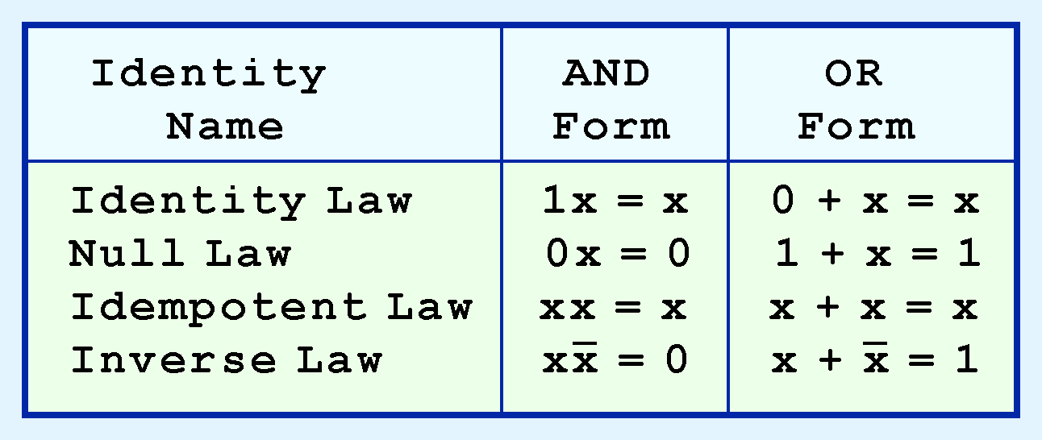
Most Boolean identities have an AND (product) form as well as an OR (sum) form. We give our identities using both forms.

Slide 23
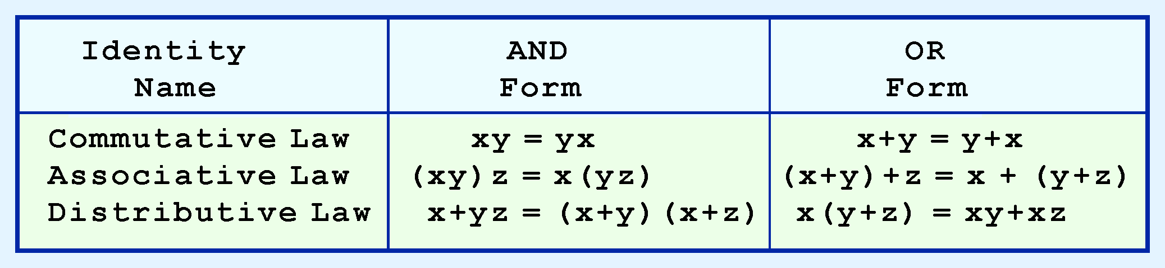
Boolean Algebra
Our second group of Boolean identities is familiar to algebra:

Slide 24
DEMORGANIZATION
Complement the entire function
Change all the ANDS(.) To ORS(+) and all the ORS (+) to ANDS (.)
Complement each of the individual variables.
  BREAK THE LINE , CHANGE THE SIGN

Slide 25
Summary
Boolean Algebra provides framework for logic simplification
De Morgans transforms between gate types
Uniting to reduce minterms
Karnaugh maps provide visual notion of simplifications
Algorithm for producing reduced form.

Slide 26
SIMPLIFICATION OF BOOLEAN EXPRESSIONS

Slide 28
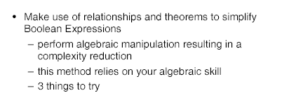
METHOD 1: MINIMIZATION BY BOOLEAN ALGEBRA

Slide 29
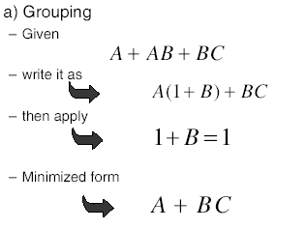

Slide 30
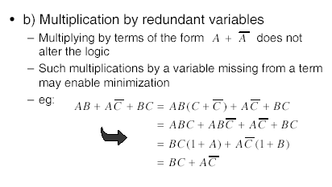

Slide 32
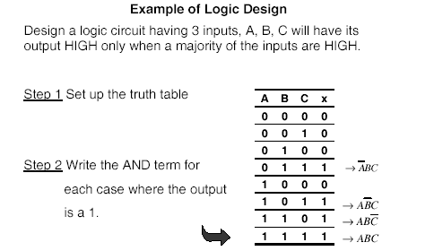

Slide 33
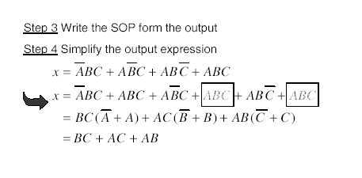

Slide 34
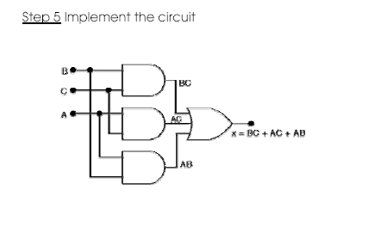

Slide 35
METHOD 2: MINIMIZATION BY KARNAUGH MAPS
The Karnaugh map provides a simple and straight-forward method of minimising boolean expressions.
With the Karnaugh map Boolean expressions having up to four and even six variables can be simplified.
A Karnaugh map provides a pictorial method of grouping together expressions with common factors and therefore eliminating unwanted variables. The Karnaugh map can also be described as a special arrangement of a truth table.

Slide 36
The diagram below illustrates the correspondence between the Karnaugh map and the truth table for the general case of a two variable problem

Slide 37
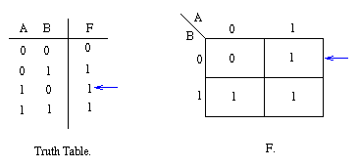
The values inside the squares are copied from the output column of the truth table, therefore there is one square in the map for every row in the truth table.
Around the edge of the Karnaugh map are the values of the two input variable.
A is along the top and B is down the left hand side.

Slide 38
The Karnaugh map uses the following rules for the simplification of expressions by grouping together adjacent cells containing ones
  No zeros allowed.
  No diagonals.
  Only power of 2 number of cells in each group.
  Groups should be as large as possible.
  Every one must be in at least one group.
  Overlapping allowed.
  Wrap around allowed.
  Fewest number of groups possible.

Slide 39
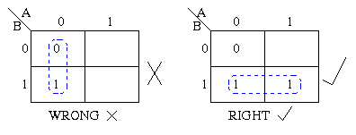
  Groups may not include any cell containing a zero

Slide 40
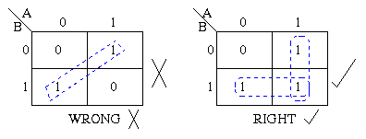
  2. Groups may be horizontal or vertical, but not diagonal.

Slide 41
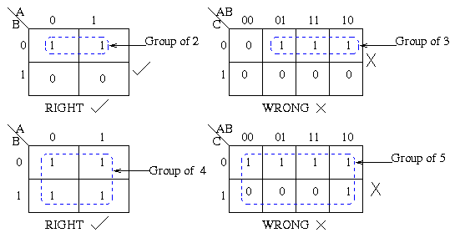
  3 .Groups must contain 1, 2, 4, 8, or in general 2n cells.
  That is if n = 1, a group will contain two 1's since 21 = 2.
  If n = 2, a group will contain four 1's since 22 = 4.

Slide 42
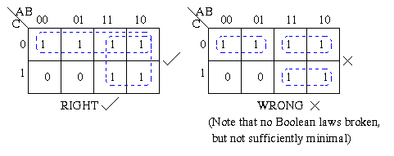
  4.Each group should be as large as possible

Slide 43
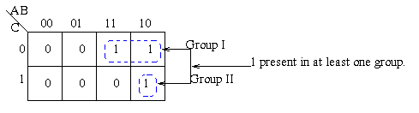
  5. Each cell containing a one must be in at least one group.

Slide 44
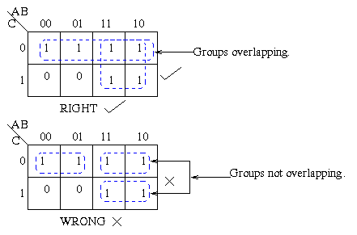
  6.Groups may overlap.

Slide 45
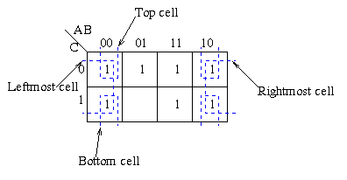
  7.Groups may wrap around the table. The leftmost cell in a row may be grouped with the rightmost cell and the top cell in a column may be grouped with the bottom cell.

Slide 46
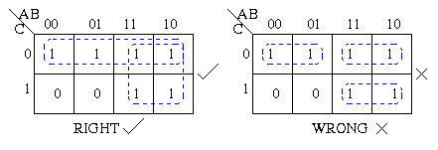
  8.There should be as few groups as possible, as long as this does not contradict any of the previous rules

Slide 47
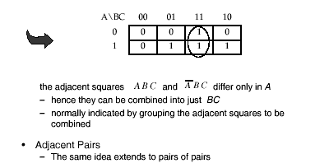
EXAMPLES

Slide 48
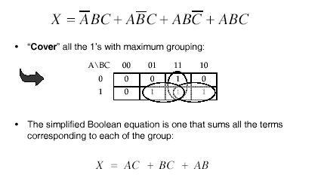

Slide 49
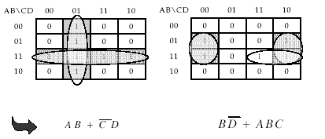
MORE EXAMPLES

Slide 50
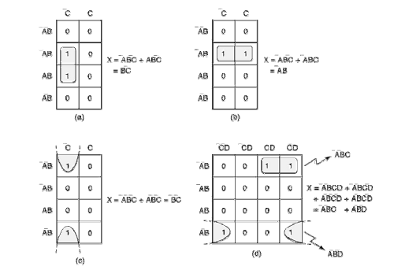

Slide 51
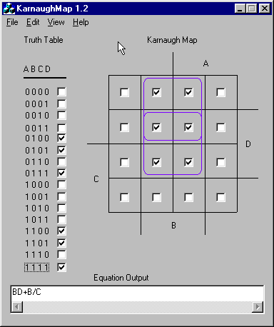

Slide 52
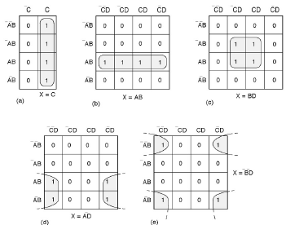

Slide 54
Complete Simplification Process
Construct the K map and place 1s and 0s in the squares according to the truth table.
Group the isolated 1s which are not adjacent to any other1s. (single loops)
Group any pair which contains a 1 adjacent to only one other 1. (double loops)
Group any octet even if it contains one or more 1s that have already been grouped.
Group any quad that contains one or more 1s that have not already been grouped, making sure to use the minimum number of groups.
Group any pairs necessary to include any 1s that have not yet been grouped, making sure to use the minimum numberof groups.
Form the OR sum of all the terms generated by each group.

Slide 55
